Slide 1
ECCV ‘20
Image-based table recognition: data, model, and evaluation
Xu Zhong, Elaheh ShafieiBavani, Antonio Jimeno Yepes
CHANGWON NATIONAL UNIVERSITY

Slide 2
Outline
Abstract
Introduction
Related work
Automatic generation of PubTabNet
Encoder-Dual Decoder (EDD) model
Tree-Edit-Distance-based Similarity (TEDS)
Experiments
Conclusion

Slide 3
Abstract
Difficult to parse into structured machine-readable format, due to complexity and diversity in table's structure and style
Dataset development : PubTabNet
Proposals
An attention-based Encoder-Dual Decoder (EDD) architecture to convert image of table into HTML code
Tree-Edit-Distance-based Similarity (TEDS) metric for table recognition

Slide 4
Outline
Abstract
Introduction
Related work
Automatic generation of PubTabNet
Encoder-Dual Decoder (EDD) model
Tree-Edit-Distance-based Similarity (TEDS)
Experiments
Conclusion

Slide 5
Introduction
Tables in documents are formatted for human understanding, human adapts
Parsing table structure
Identifying table headers
Interpreting relations between table cells
A challenge that a machine to understand tabular data in unstructured formats
Due to the large variability in table's layout and style
To represent the unstructured tables in a machine-readable format
The structure of the table, the content within each cell encoded according to a pre-defined standard
→ Table Recognition

Slide 6
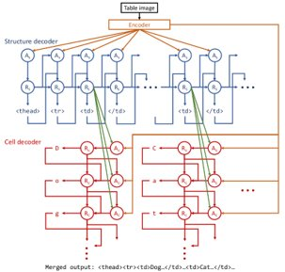
Introduction
To solve the three problems in image-based table recognition
Data
A large-scale dataset PubTabNet, which consists of over 568 K images
Model
A novel attention-based encoder-dual-decoder (EDD) architecture
Encoder : To capture the visual features of input
Structure decoder : To reconstruct table structure
Cell decoder : To recognize cell contents
Evaluation
A new Tree-Edit-Distance-based Similarity (TEDS) metric for image-based table recognition

Slide 7
Outline
Abstract
Introduction
Related work
Automatic generation of PubTabNet
Encoder-Dual Decoder (EDD) model
Tree-Edit-Distance-based Similarity (TEDS)
Experiments
Conclusion

Slide 8
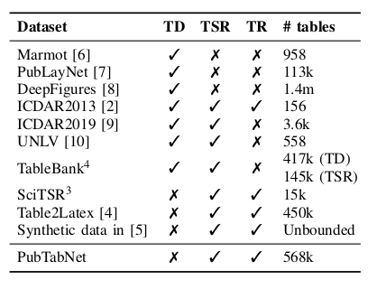
Related work – Data
To focus on three problems for analyzing tabular data in unstructured documents
Table Detection : Localizing the bounding boxes of table in documents
Table Structure Recognition : Parsing only structure (row and column layout) information of tables
Table Recognition : Parsing both the structure information and contents of table cells
PubTabNet
Image-based table
Over 6,000 journals in PMCOA
HTML (annotation)
TD : Table Detection
TSR : Table Structure Recognition
TR : Table Recognition

Slide 9
Related work – Model
To improve the performance of the attention-based encoder-decoder method on image-based table recognition with a novel EDD architecture
Difference from existing EDD architecture
The cell decoder to be trigged on when the structure decode generates a new cell
The state of structure decoder to be sent to the cell decoder to help attention on the corresponding cell in the table image

Slide 10
Outline
Abstract
Introduction
Related work
Automatic generation of PubTabNet
Encoder-Dual Decoder (EDD) model
Tree-Edit-Distance-based Similarity (TEDS)
Experiments
Conclusion

Slide 11
Automatic generation of PubTabNet
Over one million specific articles in both unstructured (PDF) and structured (XML) format in PMCOA
Easy to recognize table location of PDF via XML
Extract table area as images with a 72 pixels per inch (PPI) resolution
Convert tabular information of XML into HTML for annotation
548,592 training samples (Table images)
500,777 images

Slide 12
Outline
Abstract
Introduction
Related work
Automatic generation of PubTabNet
Encoder-Dual Decoder (EDD) model
Tree-Edit-Distance-based Similarity (TEDS)
Experiments
Conclusion

Slide 13
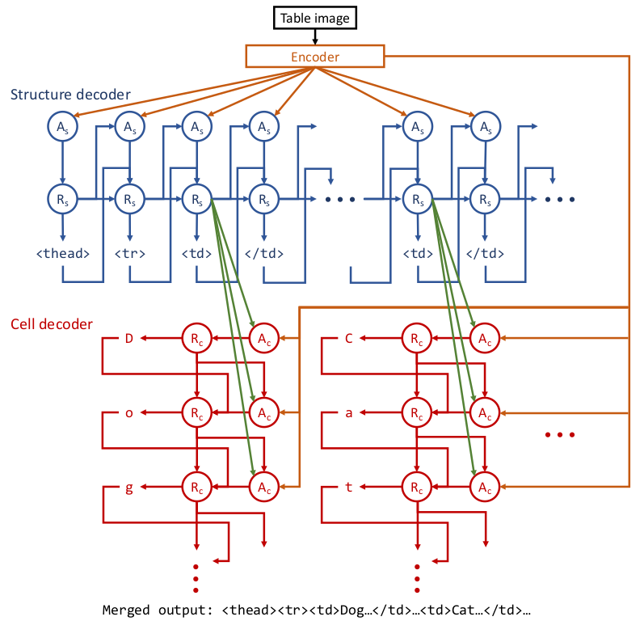
Encoder-Dual Decoder (EDD) model
The architecture of the EDD model, which consists of an encoder, an attention-based structure decoder, and an attention-based cell decoder
The encoder
A convolutional neural network (CNN)
To capture the visual feature of input table images
The structure decoder and cell decoder
Recurrent neural networks (RNN) with attention mechanism

Slide 14
Encoder-Dual Decoder (EDD) model
The structure decoder only to generate the HTML tags that define the structure of table
The cell decoder to be triggered when new cell is recognized by the structure decoder
To use the hidden state of the structure decode to compute the attention for recognizing the content of the new cell
Easy to get the final HTML representation of table after merging of the outputs of the two decoders

Slide 15
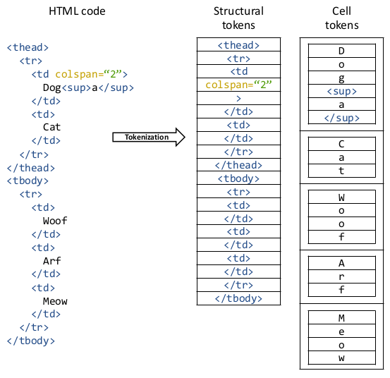
Encoder-Dual Decoder (EDD) model

Slide 16
Outline
Abstract
Introduction
Related work
Automatic generation of PubTabNet
Encoder-Dual Decoder (EDD) model
Tree-Edit-Distance-based Similarity (TEDS)
Experiments
Conclusion

Slide 17

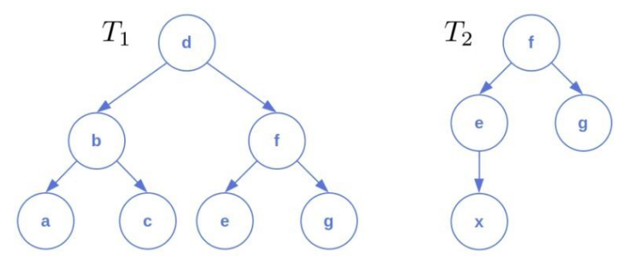
Tree-Edit-Distance-based Similarity (TEDS)
TEDS
Comparison between outputs of 2 tables
|T| = number of nodes in table
EditDist = Cost calculation of updated nodes All cost is 1 (Insertion, deletion & substitution)
EditDist(Ta, Tb) = 7
Max(|Ta|, |Tb|) = 7
TEDS(Ta, Tb) = 0

Slide 18
Outline
Abstract
Introduction
Related work
Automatic generation of PubTabNet
Encoder-Dual Decoder (EDD) model
Tree-Edit-Distance-based Similarity (TEDS)
Experiments
Conclusion

Slide 19
Experiments – Implementation
To avoid exceeding GPU RAM, the EDD model is trained on a subset (399k samples) of PubTabNet training set
Width and Height <= 512 pixels
Structural tokens <= 300 tokens
Longest cell <= 100 tokens
Total training time
About 16 days on two V100 GPUs

Slide 20
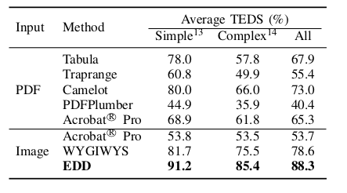
Experiments – Quantitative analysis

Slide 21
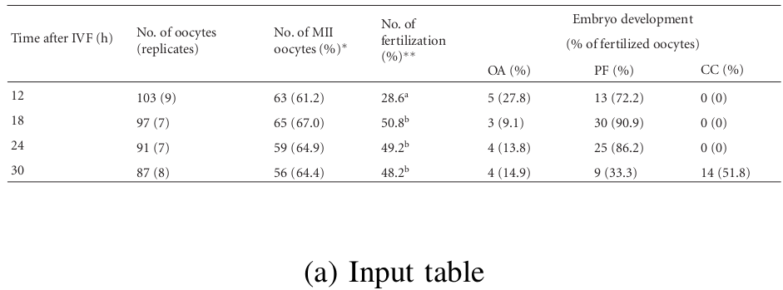
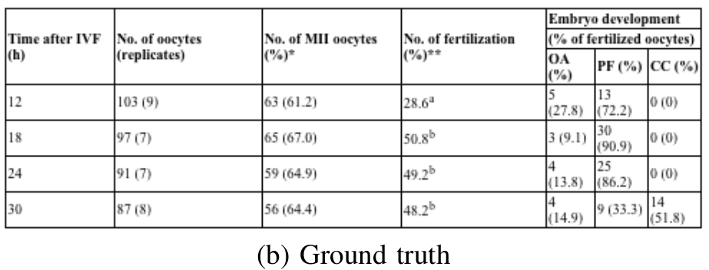
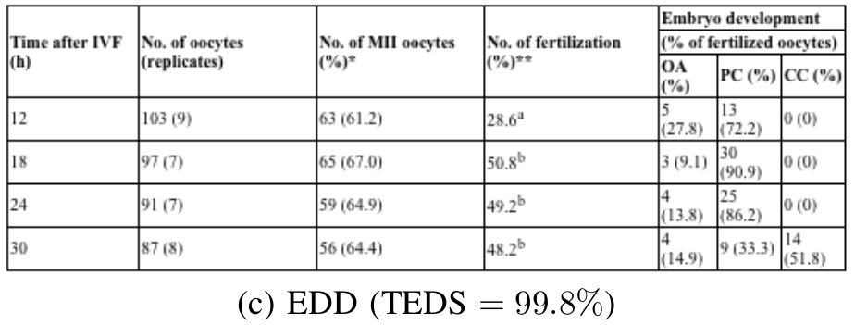
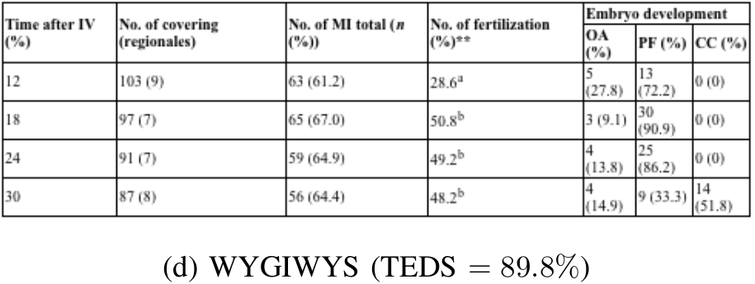
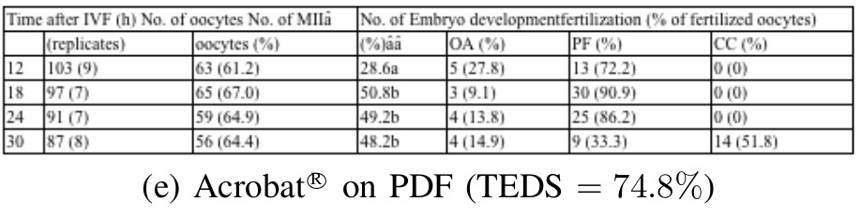
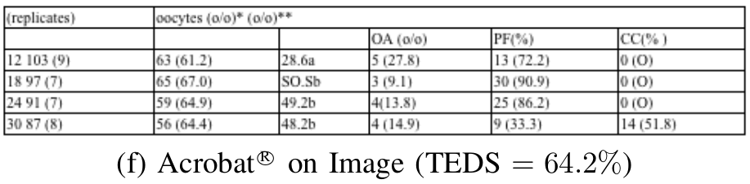
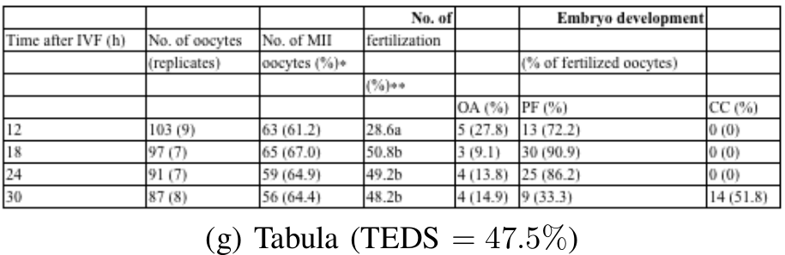
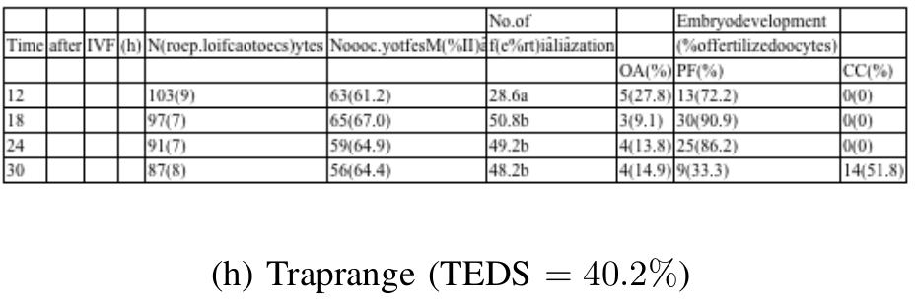
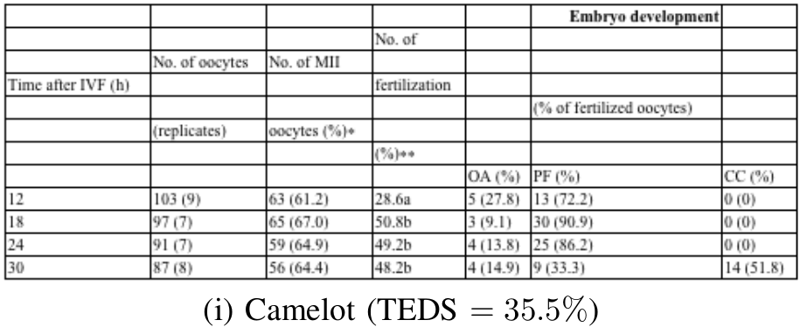
Experiments – Qualitive analysis

Slide 22
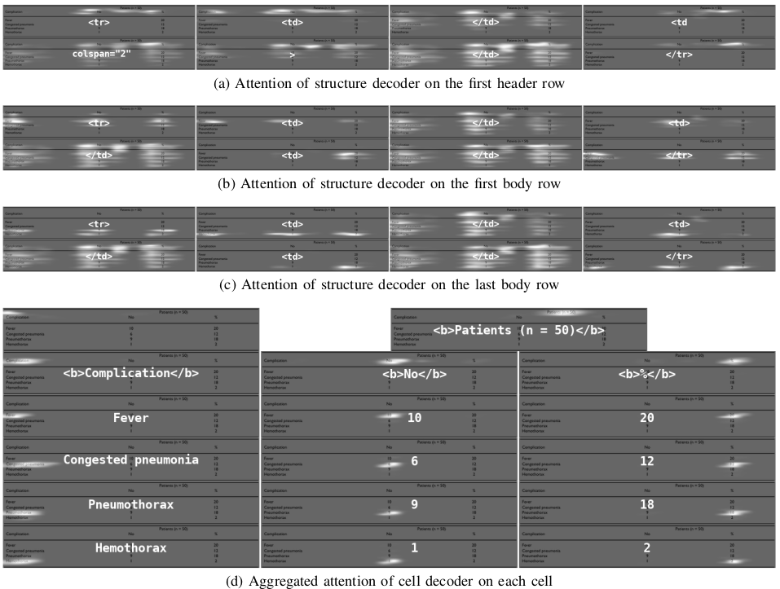
Experiments – Qualitive analysis
텍스트를 입력하십시오

Slide 23
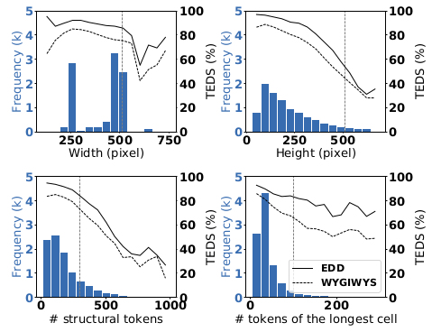
Experiments – Error analysis

Slide 24
Outline
Abstract
Introduction
Related work
Automatic generation of PubTabNet
Encoder-Dual Decoder (EDD) model
Tree-Edit-Distance-based Similarity (TEDS)
Experiments
Conclusion

Slide 25
Conclusion
Development a large-scale dataset PubTabNet to train and evaluate deep learning models
To propose an attention-based EDD model to extract table data from images
Separating table structure recognition and cell content recognition task
To propose a new evaluation metric TEDS
To capture both the performance of table structure recognition and cell content recognition
Future works
Supplement in next version of PubTabNet – Cell coordinates
Integration of EDD model and table detection neural networks

